Slide 1


Distributed Raytracer
ITCS 422 - Distributed Systems

Slide 2
Introduction
Notes:
Equipe
Contexte du projet
Presentation du projet
Methodologie (Git)

Slide 3
Summary
Distributed System
Raytracing principle
Client architecture
Server architecture

Slide 4
To what extent does the project is an implementation of a DS
?

Slide 5

Distributed System
<< A distributed system is a software system in which components located on networked computers communicate and coordinate their actions by passing messages.
The components interact with each other in order to achieve a common goal. >>

Slide 6

Distributed System
Peer-to-peer architecture
Servers are identified by Unique Identifier (UID)
Servers broadcast informations using Recursive Strategy
Clients can connect to any server
3
4
1
Connection
2

Slide 7
DS: Assigning UID
A
B
How to deal with new UID:
Scenario: “A” try to connect to “B”
Source | Destination | Message
A | B | Server Authentication: I’m a server, not a Client
B | A | Your Id is “4”
B | A | I confirm, your id is “4”
B | A | I am “1”, I’m connected to server “2”
A | B | I am connected to server “5” and “6”
Notes:
Server map

Slide 8
DS: Recursive data transfer
3
4
1
Example:
Sending informations from server 4 to server 1
Connection
Data transmission
2

Slide 9
Benefits
Save time
Share resources
Raise performance
Notes:
NB: Parler du Server Monitoring

Slide 10
What is the shared goal in this project
?

Slide 11
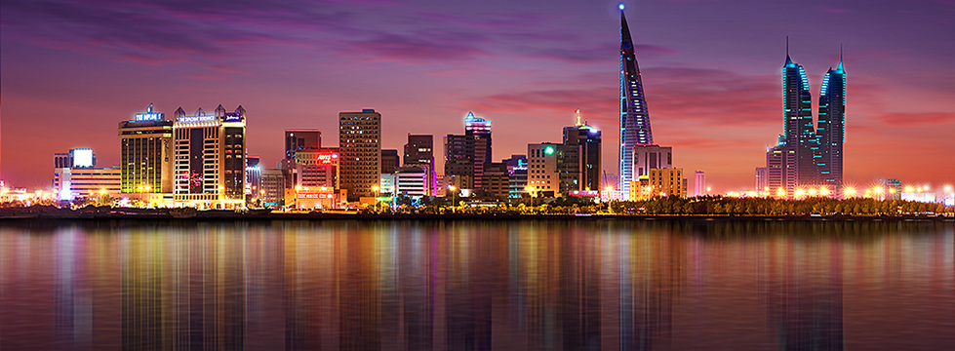
Ray Tracing principle
“Fiat Lux !”
Notes:
Principe d’optique de base: Comment IRL on percoit les objets

Slide 12
Ray Tracing principle
Notes:
Principe 2: Comment le rt percoit les objets
Draw the schema while talking

Slide 13
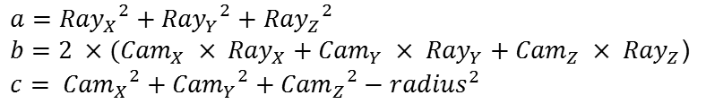


Object : Sphere
$$a={{Ray}_{X}}^{2}+{{Ray}_{Y}}^{2}+{{Ray}_{Z}}^{2}$$
$b=2 ×({Cam}_{X} × {Ray}_{X}+{Cam}_{Y} × {Ray}_{Y}+{Cam}_{Z} × {Ray}_{Z}$)
$$c= {{Cam}_{X}}^{2}+{{Cam}_{Y}}^{2}+{{Cam}_{Z}}^{2}−{radius}^{2}$$
k1
Sphere equation :
k2
$$r^{2}=x^{2}+y^{2}+z^{2}$$
$$k=\frac{−b±\sqrt{b^{2}−4ac}}{2a}$$
(k => distance between intersection and camera)
Notes:
Comment determiner la collision avec un objet d’un Vecteur directeur

Slide 14

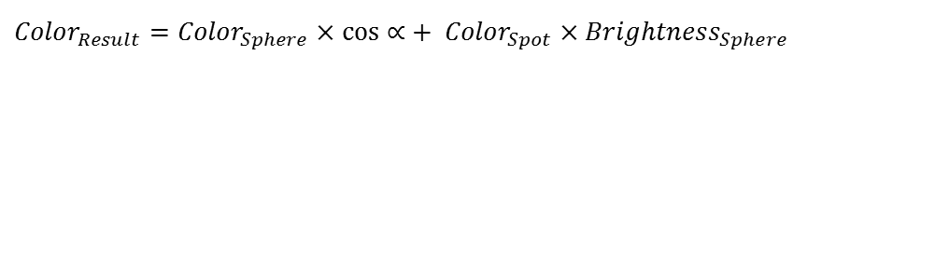
Post-treatment : Light
$${Color}_{Result}={Color}_{Sphere}×\cos{∝}+ {Color}_{Spot}×{Brightness}_{Sphere}$$
$$∝$$
Notes:
Principe du renvoi de rayon, application de post-traitement
Bastien =>diaporama sur ecran 2

Slide 15
How is the image built before calculation
?

Slide 16
Client architecture
Renderer
Calculus Worker
Listener Worker
UI Thread
Notes:
LANCEMENT DU BERCEAU DE NEWTON !
Archi

Slide 17
The client in action
Notes:
Manip du client
Notion de scene
Scene depuis save (pokemon)

Slide 18


Calculus Worker
Final Scene
CHUNK RESULT
UI Thread
Notes:
Server mapping

Slide 19
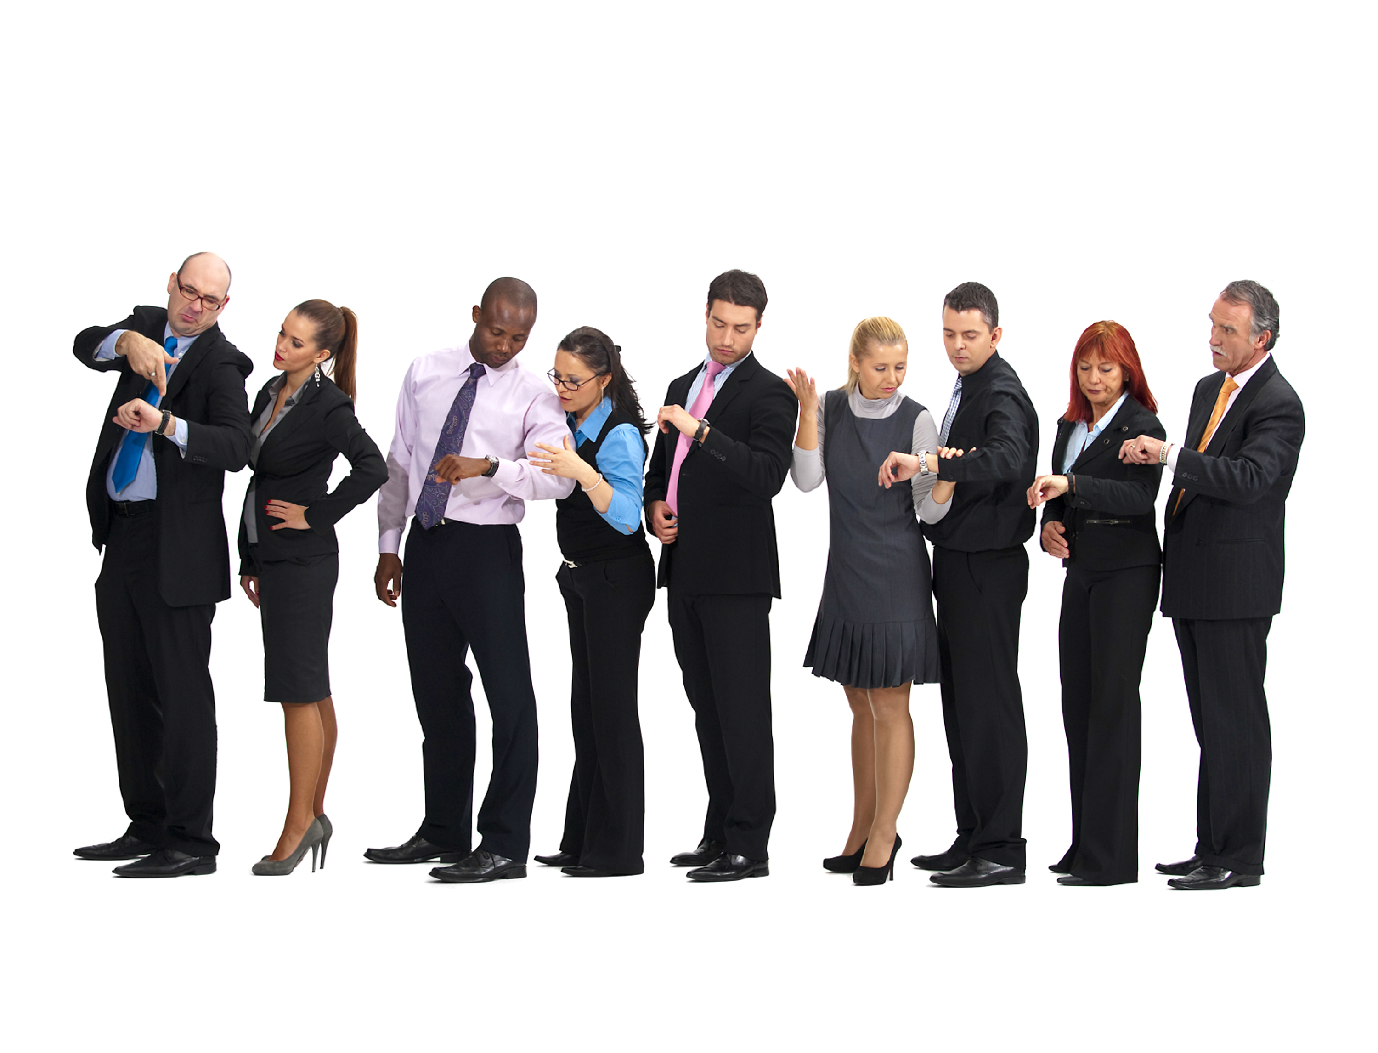
Making Animations !
Based on multiple scene alterations
Built with a collection of generated images
Notes:
Berceau de newton => end ?
Umbrella

Slide 20
How is the task distributed among the different servers
?

Slide 21
Server structure
The server is:
Using other servers
Using threads
Modular

Slide 22
Server: Task scheduling
Works by chunks
FJF
Distributes chunks to every peers available
Manages peer disconnection and latency
Notes:
Definition FJF

Slide 23
Server: Threading
Worker 1
Worker 2
Worker 3
When the network thread receives a new scene or a compute instruction, events are fired to the workers.
When a worker finishes, an event is fired back to the network thread
Worker manager
Network thread
Process
Notes:
Definition Thread
Worker manager -> event bus
(architecture event)
For calculus, => next slide

Slide 24


Server: Modular
At start, the server will search for all modules, and try to load them.
These modules include features such as :
3D objects, like sphere or cylinder
Transformations, like translation or rotation
Shaders, like opacity or reflection
Modules/
BasicLight.so
BasicObject.so
BasicTransform.so
AdvancedLight.so
Notes:
After calculus, send all colors to clients in a row

Slide 25
Let’s see it in action !
Notes:
Navigation pour exposer des gif / rendus

Slide 26
Specials thanks
For his awesomeness
Dr. Ahmed Al Jumaili
For mathematics advises
Bastien G.
Walid B.

Slide 27
Thanks for listening
Some questions ?

